Slide 1
National Park Visits
By Charles Karlson

Slide 2
About Me
Recent graduate from University of Central Florida
Graduated with a B.S. in Computer Science
Elective classes focused primarily on AI: Machine Learning Algorithms, Deep Learning, and Image Recognition.
Projects worked on in school include:
Compiler VM written in C for PL/0 (A Simple Version of Pascal intended for educational purposes)
A VM written in C that ran MIPS from a .txt file
Senior Design Capstone Project:
www.shoppingstoies.org that took 18th century store ledgers and translated the information into a nosql database.

Slide 3
About the project
This website is intended as a simple Social Media/Blog website.
Allows users to post about their visits to the United States National Parks.
Allows users to review visits by others to the different national parks and gain information and ideas for their own visits in the future.

Slide 4
Challenges
Something that I do not have much experience is front-end design for websites.
I solved this through heavy use of bootstrap and its ability to keep design uniform across the entire website as well as give the user information through convention and the user’s experience of this design across the internet.
I have also never dealt with handling user login and current user information.
I solved this through use of the Springframework security.

Slide 5
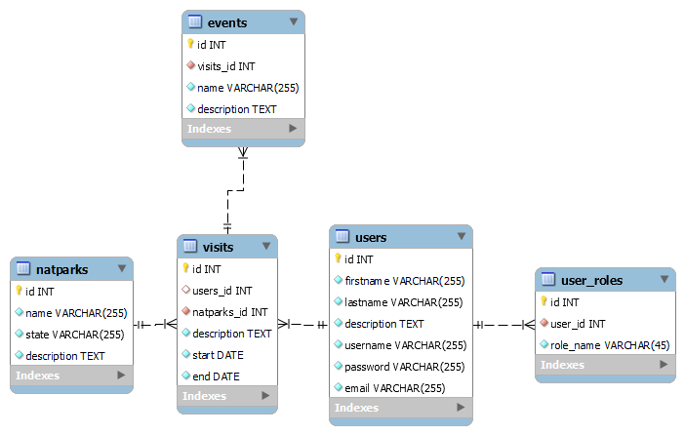
Database Schema

